Slide 1

SENSOR AND TRANSDUCERS
DARBHANGA COLLEGE OF ENGINEERING
DARBHANGA
INSTRUMENTATION AND CONTROL
(SEM-IV:ME)
Course Code- PCC-ME 207

Slide 2
INTRODUCTION
•
Transducer
a device that converts a primary form of energy into a corresponding signal with a different energy form
  Primary Energy Forms: mechanical, thermal, electromagnetic, optical, chemical, etc.
take form of a sensor or an actuator
Sensor (e.g., thermometer)
a device that detects/measures a signal or stimulus
acquires information from the “real world” Actuator (e.g., heater)
a device that generates a signal or stimulus
•
•
sensor intelligent
real
world
feedback
actuator system

Slide 3
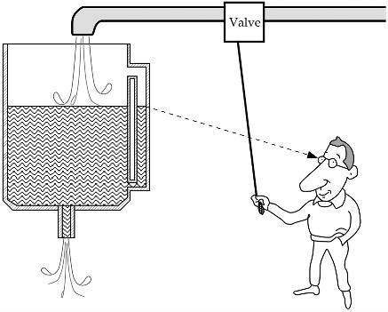
Sensor
●
A Device that receives and respond to a signal or stimulus

Slide 4

Sensor Systems
Typically interested in electronic sensor
– convert desired parameter into electrically measurable signal
General Electronic Sensor
–
–
primary transducer: changes “real world” parameter into electrical signal secondary transducer: converts electrical signal into analog or digital values
real world
primary transducer
analo g
secondary transducer
usable values
_{s}s_{e}i_{n}g_{s}n_{o}al_{r}
•
Typical Electronic Sensor System
input signal
(measurand)
microcontroller
signal processing communication
sensor
sensor data analog/digital
network display

Slide 5
Sensor Classification
Passive
Doesn’t need any additional energy source
Directly generate an electric signal in response to an external stimuli
E.g. Thermocouple, photodiode, Piezoelectric sensor
Active
Require external power called excitation signal Sensor modify excitation signal to provide output
E.g. thermistor, resistive strain gauge
•
•
•
•
•
•
•
•

Slide 6
Sensor characteristics
Span or Full scale input
  A dynamic range of stimuli which may be converted by a sensor
  represents the highest possible input value that can be applied to the sensor without causing an unacceptably large inaccuracy
  g for accelerometer
Full scale output
  algebraic difference between the electrical output signals measured with maximum input stimulus and the lowest input stimulus applied
  E.g. LM35

Slide 7
Sensor characteristics
Accuracy
  Accuracy is measured as a highest deviation of a value represented by the sensor from the ideal or true value at its input
  accuracy limits generally are used in the worst-case analysis to determine the worst possible performance of the system
  The inaccuracy rating may be represented in a number of forms:
    Directly in terms of measured value ()
    In percent of input span (full scale)
    In terms of output signal

Slide 8
Sensor characteristics
Calibration
  determination of specific variables that describe the overall transfer function
    Overall means of the entire circuit, including the sensor, the interface circuit, and the A/D converter
  E.g. use of forward biased diode for temperature measurement
    Transfer function v=a+bt
    Take measurement at two T’s and solve and determine a and b
– V1=a+bt1 and V2=a+bt2
  For Non-linear function more than one point can be required depending on the transfer function
  Another way is to use a piecewise approximation

Slide 9
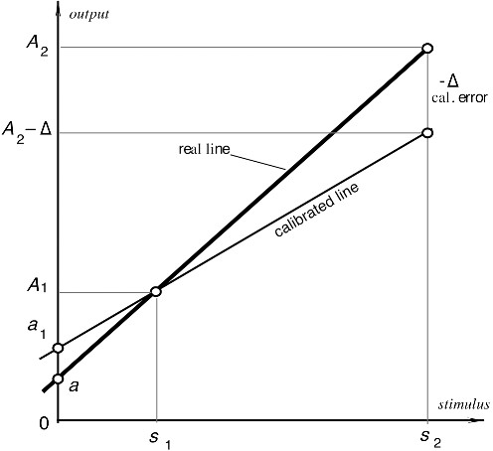
Sensor characteristics
Calibration error
– inaccuracy permitted by a manufacturer when
a sensor is calibrated in the factory
Error is systematic in nature

Slide 10
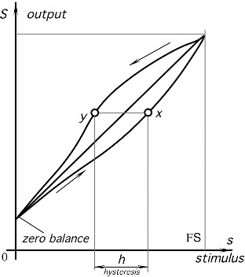
Sensor characteristics
Hysteresis
– deviation of the sensor’s output at a specified point of the input signal when it is approached from the opposite directions

Slide 11
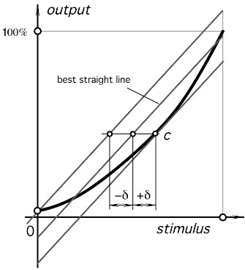
Sensor characteristics
Non-linearity error
– specified for sensors whose transfer function may be approximated by a straight line

Slide 12
Sensor characteristics
Repeatability
  caused by the inability of a sensor to represent the same value under identical conditions
  It is expressed as the maximum difference between output readings as determined by two calibrating cycles
  It is usually represented as % of FS

Slide 13
Sensor characteristics
Resolution
  the smallest increments of stimulus which can be sensed
Output impedance
  The output impedance Zout is important to know to better interface a sensor with the electronic circuit
  For a current generating sensor should have an output impedance as high as possible and the circuit’s input impedance should be low
  For the voltage connection, a sensor is preferable with lower Zout and the circuit should have Zin as high as practical

Slide 14
Classification of Transducers
Transducers
On The Basis of principle Used
Active/Passive
Primary/Secondary
Analogue/Digital
Transducers/ Inverse Transducers
Capacitive
Inductive
Transducers may be classified according to their application, method of energy conversion, nature of the output signal, and so on.
Resistive
14

Slide 15
Selecting a Transducer
•
•
What is the physical quantity to be measured?
Which transducer principle can best be used to measure this quantity?
What accuracy is required for this measurement?
Fundamental transducer parameters
Physical conditions
Environmental conditions
Compatibility of the associated equipment
Reducing the total measurement error :
Using in-place system calibration with corrections performed in the data reduction
Artificially controlling the environment to minimize possible errors
•
•
15

Slide 16
Transducer, Sensor, and Actuator
•
Transducer:
a device that converts energy from one form to another
Sensor:
converts a physical parameter to an electrical output (a type of transducer, e.g. a microphone)
Actuator:
converts an electrical signal to a physical output (opposite of a sensor, e.g. a speaker)
•
•
•
16

Slide 17
1.DISPLACEMENT,POSITION & PROXIMITY
Displacement sensors are concerned with the measurement of the amount by which some object has been moved.
Position sensors are concerned with the determination of the position of some object in relation to some reference point.
Proximity sensors are a form of position sensor and are used to determine when an object has moved to within some particular critical distance of the sensor. They are essentially devices which give on/off outputs.

Slide 18
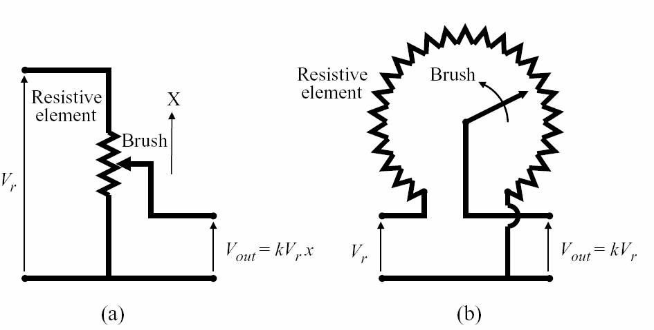
1.1 Potentiometer Sensor
•
Potentiometer is one of the common sensors for position measurements.
It relates the change in position (linear or rotary) into the change in resistance, as shown in Figure a and b
•

Slide 19
Cont….
•
The resistance change is then converted to a proportional voltage change in the electrical circuit of the sensor.
Hence, the relationship between the measured physical variable, translational displacement x or rotary displacement θ, and the output voltage for a ideal potentiometer is
•
where the sensitivity, (k * Vr ) , of the potentiometer is a function of the winding resistance and physical shape of the winding.

Slide 20
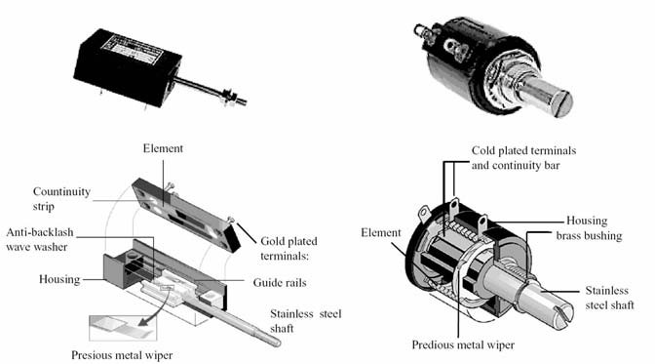
Potentiometer Picture

Slide 21
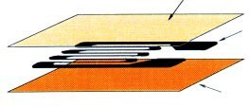
1.2 Strain Gauge
•
•
Strain gauge: it is an electrical conductor whose resistance changes as it is strained.
Structure of Strain Gauges
There are many types of strain gauges. Among them, a universal strain gage has a structure such that a grid-shaped sensing element of thin metallic resistive foil (3 to 6μm thick) is put on a base of thin plastic film (15 to 16μm thick) and is laminated with a thin film.
Laminate film
Metallic resistive foil (sensing element)
Plastic film (base)

Slide 22
Cont.…
•
•
Principle of Strain Gages
The strain gage is tightly bonded to a measuring object so that the sensing element (metallic resistive foil) may elongate or contract according to the strain borne by the measuring object.
When bearing mechanical elongation or contraction, most metals undergo a change in electric resistance.
The strain gage applies this principle to strain measurement through the resistance change. Generally, the sensing element of the strain gage is made of a copper-nickel alloy foil.
The alloy foil has a rate of resist-ance change proportional to strain with a certain constant.
Let’s express the principle as follows:
•
•
•
ΔR = K.ε R
where, R: Original resistance of strain gage, Ω (ohm)
ΔR: Elongation- or contraction-initiated resistance change, Ω (ohm) K: Proportional constant (called gage factor)
ε: Strain

Slide 23
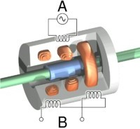
1.3Linear Variable Differential Transformer (LVDT)
Principle of LVDT:
LVDT works under the principle of mutual induction, and the displacement which is a non-electrical energy is converted into an electrical energy.
And the way how the energy is getting converted is described in working of LVDT in a detailed manner.

Slide 24
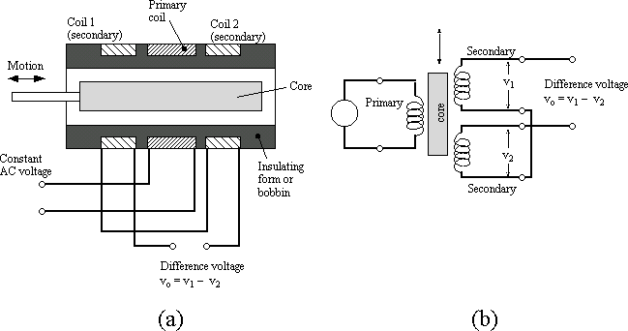
Cont.…
•
Construction of LVDT:

Slide 25
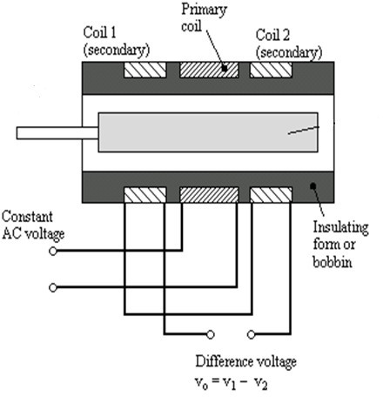
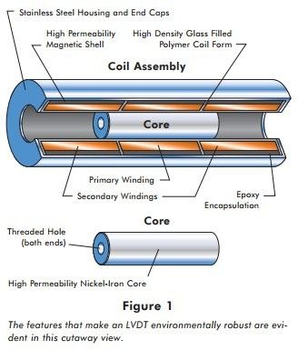
LVDT consists of a cylindrical former where it is surrounded by one primary winding in the centre of the former and the two secondary windings at the sides.

Slide 26
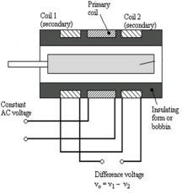
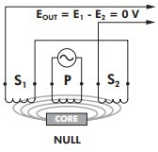
Case 1:
Working of LVDT:
On applying an external force which is the displacement, if the core reminds in the null position itself without providing any movement then the voltage induced in both the secondary windings are equal which results in net output is equal to zero
Esec1-Esec2=0

Slide 27
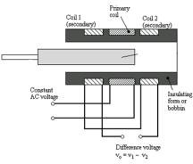
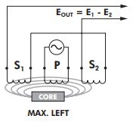
Case 2:
Working of LVDT:
When an external force is applied and if the steel iron core tends to move in the left hand side direction then the emf voltage induced in the secondary coil is greater when compared to the emf induced in the secondary coil 2.
Therefore the net output will be Esec1-Esec2

Slide 28
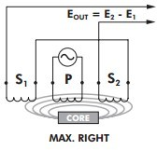
Case 3:
Working of LVDT:
When an external force is applied and if the steel iron core moves in the right hand side direction then the emf induced in the secondary coil 2 is greater when compared to the emf voltage induced in the secondary coil 1.
The net output voltage will be Esec2-Esec1

Slide 29
Advantages of LVDT:
Infinite resolution is present in LVDT
High output
LVDT gives High sensitivity
Very good linearity
Ruggedness
LVDT Provides Less friction
Low hysteresis
LVDT gives Low power consumption.

Slide 30
Applications of LVDT:
LVDT is used to measure displacement ranging from fraction millimeter to centimeter.
Acting as a secondary transducer, LVDT can be used as a device to measure force, weight and pressure, etc..

Slide 31
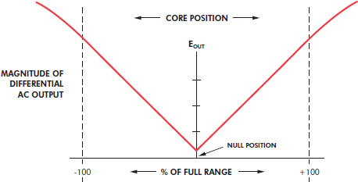
Characteristics of LVDT:

Slide 32
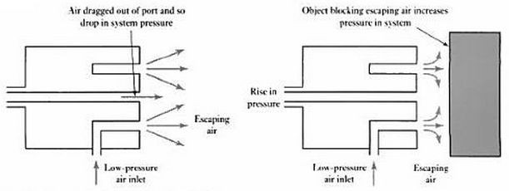
1.5 Pneumatic Sensor
•
Pneumatic sensors are displacement sensors and use compressed air to measure the displacement of objects. Whenever the body whose displacement we want to measure changes its position will result in the change in air pressure.
If we look at the working of pneumatic sensor, we have low pressure air escape from the port in front of sensor. If we don’t have any object in front of sensor, this air will escape and reduce air pressure in the nearby output port. But if we have an object in the path of compressed air then air will escape and increase air pressure at sensor output port. The rise in output pressure depends upon the closeness of the
•
object.
These sensors are used to work for short range applications ranging from 3 mm to 12 mm.

Slide 33
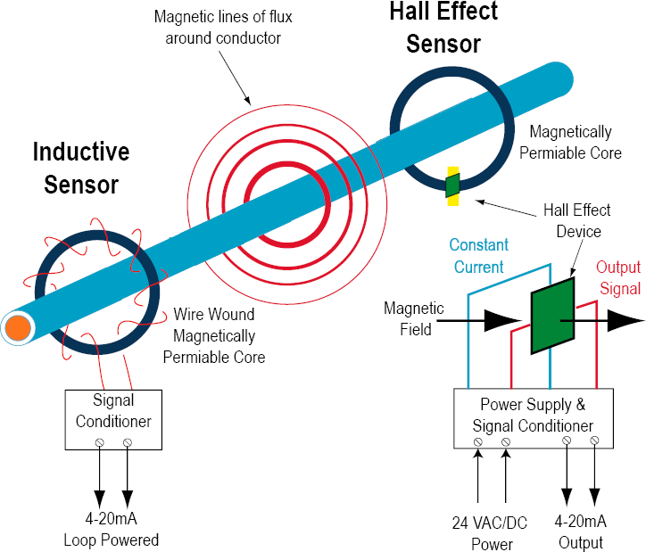
1.6Hall Effect Sensor
•
A Hall effect sensor is a transducer that varies its output voltage in response to a magnetic field. Hall effect sensors are used for proximity switching, positioning, speed detection, and current sensing applications.

Slide 34
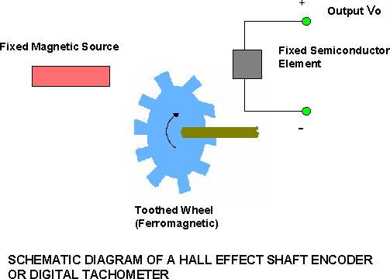
2Velocity sensors
2.1 Tachogenerator

Slide 35
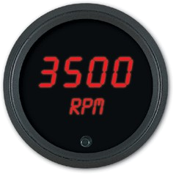
➢
The semiconductor element and the magnetic source are fixed relative to one another in a single package.
➢
By moving the ferromagnetic member into the air gap between the magnetic source and the semiconductor element, the flux linkage can be altered. This changes Vo.
➢
Suitable both as an analog proximity sensor and as a limit switch.
➢
The relationship between the output voltage Vo and the distance of a Hall effect sensor measured from the moving member is non linear. Linear Hall effect sensors use calibration to linearize their outputs.
DIGITAL TACHOMETER

Slide 36
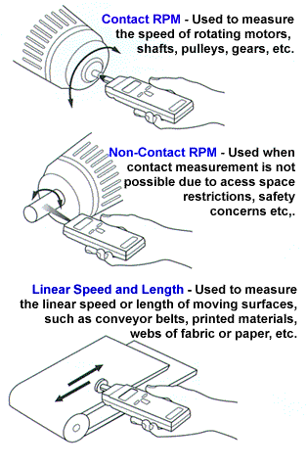
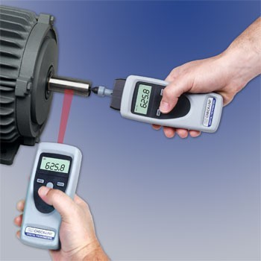
WHERE USED:

Slide 37
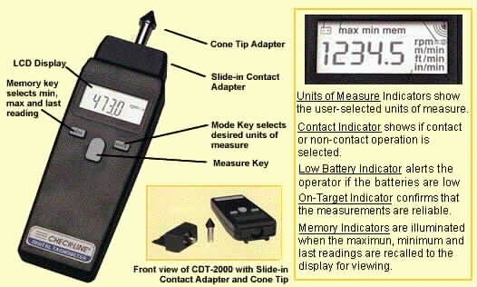
DIGITAL TACHOMETER AS A MEASUREMENT DEVICE

Slide 38
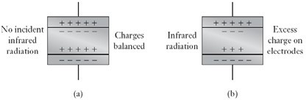
2.2Pyroelectric Sensor
This charge leaks away through the measurement circuit until the charge on the crystal once again is balanced by the charge on the electrodes.

Slide 39
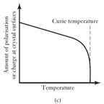
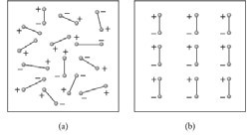
Cont.…
Pyroelectric (from the Greek pyr, fire, and electricity) materials, e.g. lithium tantalate, are crystalline materials which generate charge in response to heat flow.
Polarising a pyroelectric material
The effect of temperature on the amount of polarisation.

Slide 40

Cont.…
The pyroelectric sensor thus behaves as a charge generator which generates charge when there is a change in its temperature as a result of the incidence of infrared radiation.
For the linear part of the graph shown below , when there is a temperature change the change in charge is proportional to the change in temperature.

Slide 41
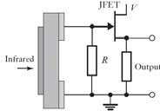
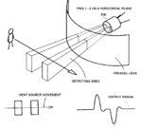
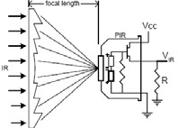
Cont
…
When the sensor is idle, both slots detect the same amount of IR, the ambient amount radiant from the room or walls or outdoors. When a warm body like a human or animal pass by, it first intercepts one half of the sensor, which causes a positive differential change between t two halves.
When the warm body leaves the sensing area, reverse happens, whereby the sensor generate negative differential change.
Dual pyroelectric sensor

Slide 42
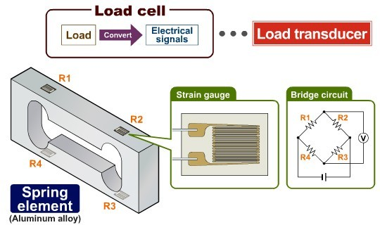
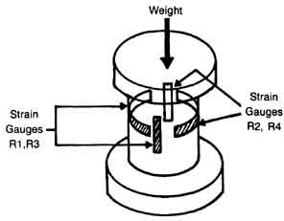
3.FORCE SENSOR
3.1 Strain Gauge Load Cell
A load cell is a “load transducer” which converts the weight or load acting on it into electrical signals.
A load cell is composed of an aluminum alloy spring element, strain gauges (serving as sensors) and a bridge circuit.
The strain gauges themselves are bonded onto four areas which become considerably distorted in the spring element. The load cell detects the force of the distortion as voltage change.
•
•
•

Slide 43
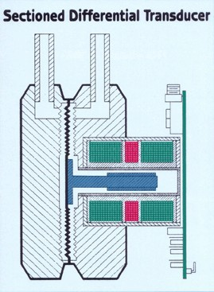
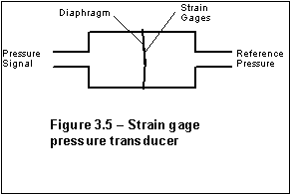
4.PRESSURE SENSOR
4.1 Diaphragm
LVDT WITH DIAPHRAGM

Slide 44
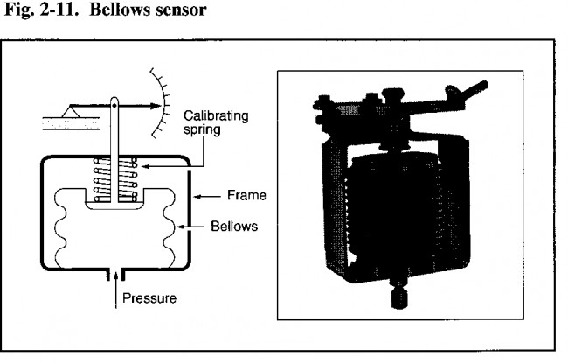
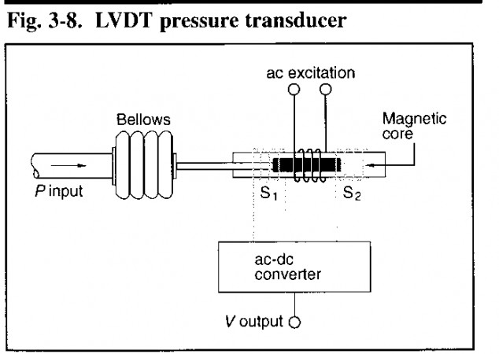
4.2 BELLOWS

Slide 45
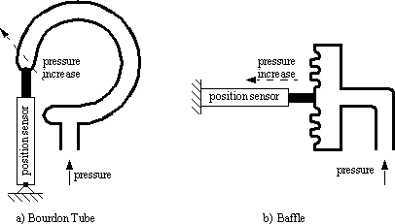

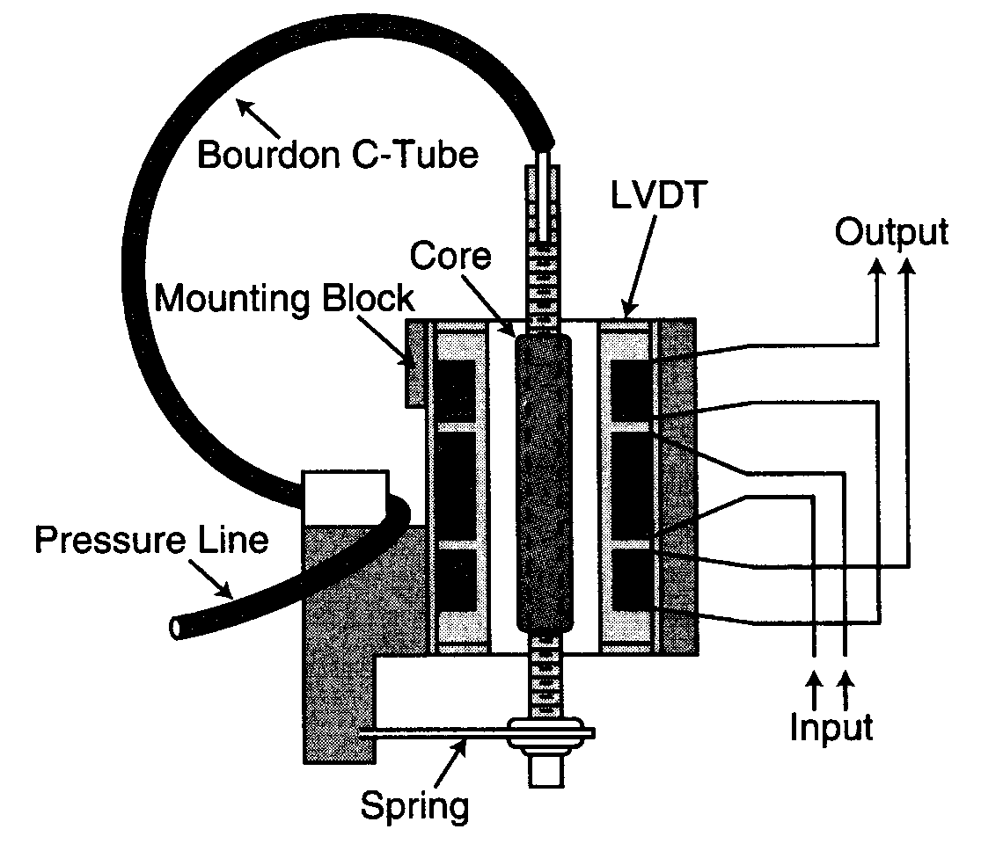
4.3TUBE PRESSURE SENSOR
BOURDON TUBE

Slide 46








4.4Piezoelectric actuators and sensors
Piezoelectric effect (sensor)
An electric field is generated due to a change in dimensions of a material
(Curie brothers 1880)
Converse Piezoelectric effect
(actuator)
A change in dimensions of a material due to the
Application of an electric field
+
-
-
+

Slide 47
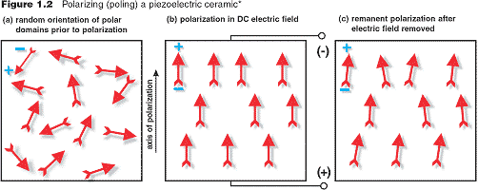
Polarisation of a piezoelectric material
Subject a piezoelectric material to a large voltage near the Curie temperature then the dipoles align
dipole
Curie temperature is the temperature above which the material loses its piezoelectric property

Slide 48
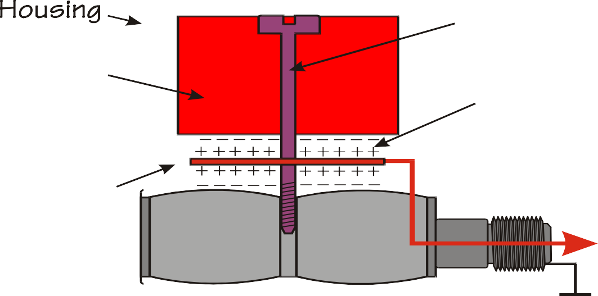
Practical Accelerometer Designs
Compression Type
▪
Advantages
Few Parts / Easy to Fabricate
High Resonant Frequency
▪
Disadvantages
Very high thermal transient sensitivity
High base strain sensitivity

Slide 49
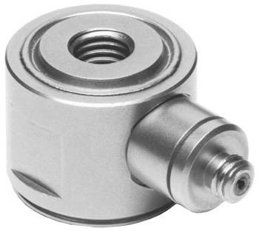
Piezoelectric Force Transducer
Preload stud
Electrical output
Piezoelectric element
Can be used in tension and compression
Fragile to moments

Slide 50
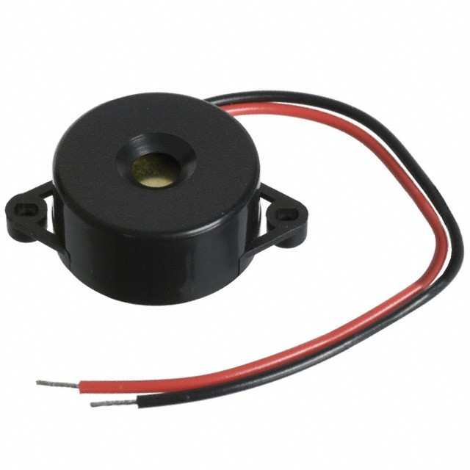
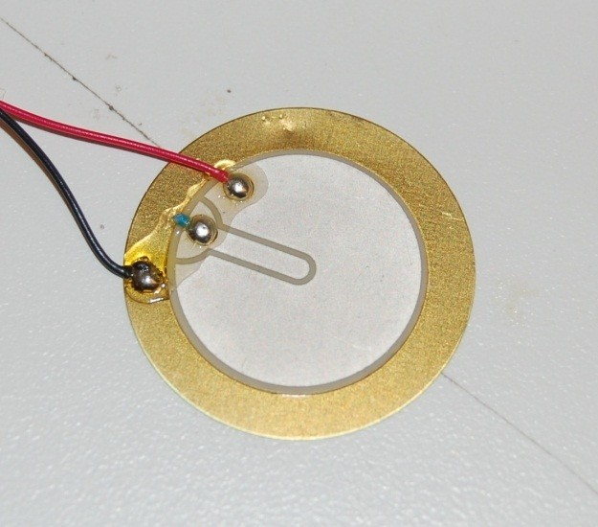
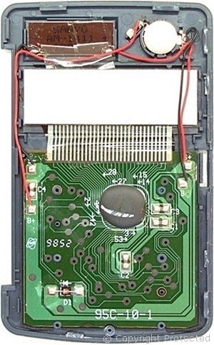

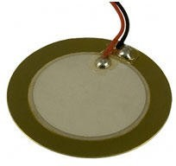
PIEZOELECTRIC SENSORS

Slide 51
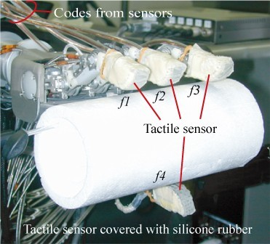
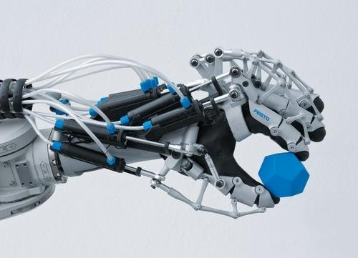
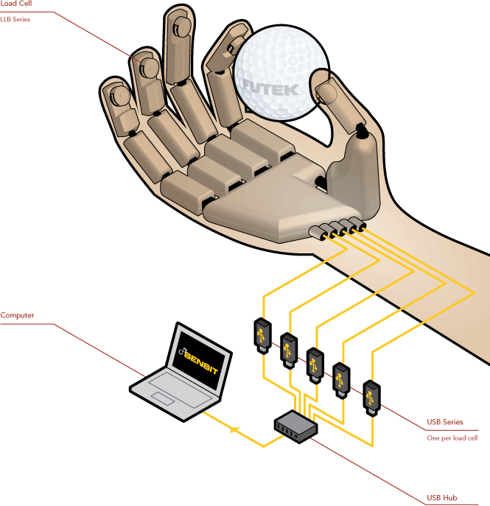

4.5 Tactile Sensor
The term tactile sensor usually refers to a transducer that is sensitive to touch, force, or pressure.
The term tactile sensor usually refers to a transducer that is sensitive to
touch, force, or pressure.
Tactile sensors are useful in a wide variety of applications for robotics and computer hardware and even security systems.

Slide 52
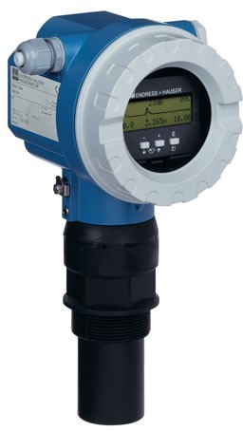
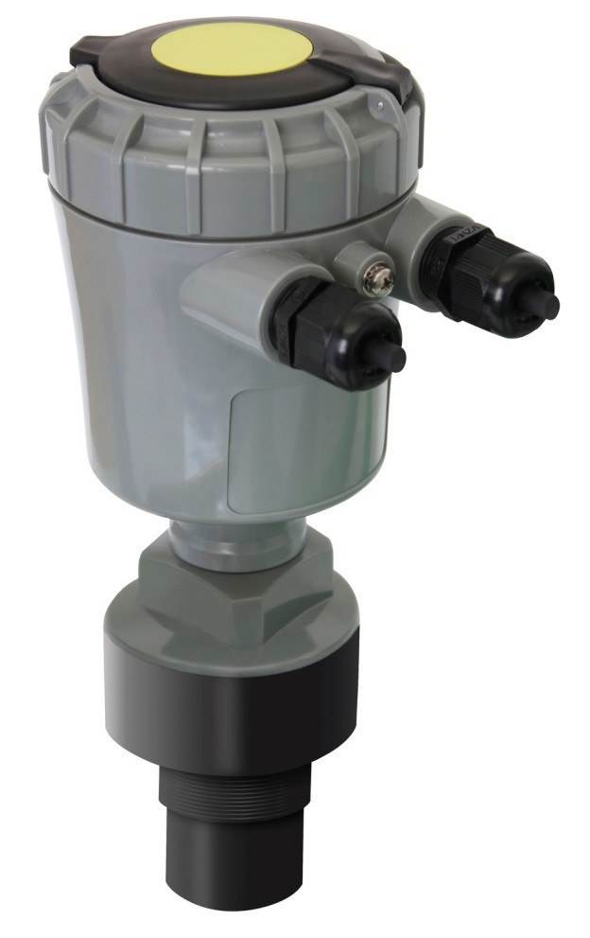


5. Level Sensor

Slide 53




Cont.…
CAPACITIVE METHOD
BALL FLOAT

Slide 54

6.Signal Conditioning
Signal conditioning is the operation performed on the signal to convert them to a form suitable for interfacing with other elements in the process control

Slide 55
6.1Signal-level and bias changes
The method to adjust the level (magnitude) and bias (zero value) of voltage signal
For example
Signal conditioning circuit
0.2 V – 0.6 V
0 V – 5 V

Slide 56
Zero shift
Amplification
0.2 V – 0.6 V
0 V – 0.4 V
0 V – 5 V

Slide 57

6.2Linearization
Often, the characteristic of a sensor is nonlinear
Special circuit were devised to linearize signals
Modern approach is to use computer software to linearize

Slide 58
6.3Conversion
The circuit to covert one form of signal or physical values into the other form
– Resistance to voltage
Typical conversion is to convert resistance or voltage to 4 to 20 mA and convert back to voltage at the receiving end
Thus, voltage-to-current and current-to- voltage circuits are essential

Slide 59
6.4Digital Interface
The use of computer is process control requires the conversion of analog to digital signal
  ADC
  DAC

Slide 60

6.5Filtering
•
•
•
Some signals input are spurious (contain more than 1 frequency) It is necessary to filter the frequency matched with the devices Example
Highpass, lowpass, bandpass filter
Band Pass Filters passes signals within a certain "band" or "spread" of frequencies without distorting the input signal or introducing extra noise. This band of frequencies can be any width and is commonly known as the filters Bandwidth.

Slide 61
Cont.…
The passive filter networks use only passive elements such as resistors, inductors and capacitors.
The active filter circuits use the active elements such as op- amps, transistors along with the passive element.
Modern active filters do not use inductors as they are bulky, heavy & non-linear.
The inductors generate the stray magnetic fields. They dissipate considerable amount of power.

Slide 62
Four types of filters - “Ideal”
PASSIVE FILTERS
lowpass highpass
bandpass
bandstop

Slide 63
6.6Impedance Matching
Connecting the sensors or process control element with different impedance causes signal reflection
The network or circuit to match impedance thus to reduce signal reflection

Slide 64
6.7Concept of Loading
When the sensor or circuit is connected to load, this will introduce the uncertainty in the measurement (amplitude of voltage)

Slide 65
The output voltage is calculated using voltage division as
R_{L}
⎞
V = V ⎛
⎜
y x
R + R ÷
⎝ L x ⎠
⎛
R_{x}
⎞
= V 1−
⎜
x
R + R ÷
⎝ x ⎠
L
Output voltage is reduced by the voltage drop
To reduce the uncertainty,
R_{L} ≥ R_{x}

